Slide 1

K.S. INSTITUTE OF TECHNOLOGY
Department of Computer Science and Engineering
Project on
DIVERSE IOT BASED GADGETS TO UPDATE A
MODERATE CONDITION OF FARMERS IN INDIA
Batch no:2021_CSE_10
Team members:
Poojashree.K 1KS18CS067
Rekha N.C 1KS18CS082
Shalini.S 1KS18CS090
Preethi.K 1KS18CS072
Under the guidance of Dr.K.Venkata Rao Professor
Dept. of CSE,KSIT

Slide 2
ABSTRACT
Agriculture is the backbone of India and also plays an important role in Indian economy by providing a certain percentage of domestic product to ensure the food security.
The Internet of things (IoT) integrates technological systems using virtual network communication and cloud data bases
The approach builds a network of commercial system users, agricultural technology providers and IT experts and promises efficiency and sustainability improvements in agriculture.
This robotic vehicle is an agricultural machine of a considerable power and great soil clearing capacity.
This multipurpose system gives an advance method to plow, leveling of farm ,seed sowing , harvesting with minimum man power and labor making it an efficient vehicle.

Slide 3
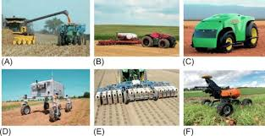
The machine will cultivate the farm by considering particular rows and specific column at fixed distance depending on crop.
The vehicle can be controlled through Internet medium using a Android smart phone.
The whole process calculation, processing, monitoring are designed with motors & sensor interfaced with microcontroller. Using Internet of things the robot is controlled.

Slide 4
OBJECTIVE
The main objective of this project is to design an integrated automated system that accounts to reduce manual monitoring of the field.
This multipurpose system gives an advance method to sow, plow, water and cut the crops with minimum man power and labor making it an efficient vehicle.
The Pi Camera and PIR Sensor used for Animal detection.
The approach builds a network of commercial system users, agricultural technology providers and IT experts and promises efficiency and sustainability improvements in agriculture.
The proposed system will be able to measure important parameters of the crop and send out the information to the field manager and this data can be analysed by the field manager to take the necessary action to improvise the crop of his/her field.

Slide 5
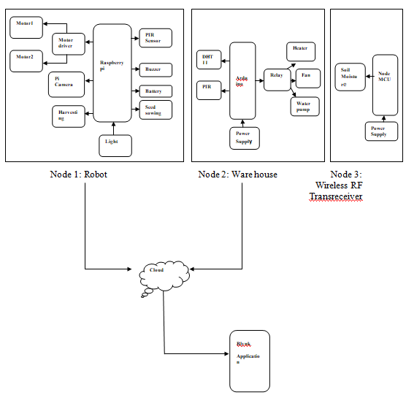
PROJECT REQUIREMENTS

Slide 6
PROJECT REQUIREMENTS
HARDWARE COMPONENTS
SOFTWARE COMPONENTS
Node MCU
Raspberry Pi
Pi Camera
Arduino
PIR Sensor
Relay
L293D Motor driver
DH11 sensor
Soil Moisture sensor
Etc..
Arduino IDE
Mobile App
Python
Pycharm
Pandas
SK learn

Slide 7
APPLICATIONS
Crop monitoring is future of IoT in agriculture: A crop monitoring device is major element of precision farming. Similar to weather forecasting stations, these devices are placed in the farm to collect necessary data for farming like the temprature of soil, water potential etc..
Greenhouse Automation: In addition to sourcing environmental data, weather stations can automatically adjust the conditions to match the given parameters. Specifically, greenhouse automation systems use a similar principle.
Crop Management: One more type of IoT product in agriculture and another element of precision farming is crop management devices. Just like weather stations, they should be placed in the field to collect data specific to crop farming; from temperature and precipitation to leaf water potential and overall crop health, these can all be used to readily collect data and information for improved farming practices.

Slide 8
REFERENCE:
[1] Akshay Khandelwal1 , Ajay Vikram Singh2 ,”Diverse IOT Based Gadgets to update a Moderate condition of farmers in India” Amity Institute of Information Technology, Amity University, Noida, India 1 khandelwalakshay95@gmail.com, 2 avsingh1@amity.edu, 3 skkhatri@amity.edu 2019 IEEE
[2] Sinha, G. R. “Advances in IoT and Smart Sensors for Remote Sensing and Agriculture Applications. Remote Sens”. 2021
[3] C. Yoon, M. Huh, S. Kang, J. Park and C. Lee, "Implement smart farm with IoT technology," 2018 20th International Conference on Advanced Communication Technology (ICACT), Chuncheon-siGangwon-do, Korea (South), 2018, pp. 1-2.
[4] R. F. Maia, I. Netto and A. L. H. Tran, "Precision agriculture using remote monitoring systems in Brazil," 2017 IEEE Global Humanitarian Technology Conference (GHTC), San Jose, CA, 2017, pp. 1-6.
[5] S. Vashi, J. Ram, J. Modi, S. Verma and C. Prakash, "Internet of Things (IoT): A vision, architectural elements, and security issues," 2017 International Conference on I-SMAC (IoT in Social, Mobile, Analytics and Cloud) (I-SMAC), Palladam, 2017, pp. 492-496.
[6] J. Grand C. Molina-Colcha, S. Hidalgo-Lupera and C. Valarezo "Design and Implementation of a Wireless Sensor Network for Precision Agriculture Operating in API Mode," 2018 International Conference on eDemocracy & eGovernment(ICEDEG), Ambato, 2018, pp. 144-149.
[7] S. Gio, I. Seitanidis, M. Ojo, D. Adam and F. Ving, "IoT solutions for crop protection against wild animal attacks," 2018
[8] A. Usman and N. K. Verma, "Internet of Things (IoT): A relief for Indian farmers," 2016 IEEE Global Humanitarian Technology Conference (GHTC), Seattle, WA, 2016, pp. 831- 835.

Slide 9
THANK YOU

